Slide 1




ASP.NET MVC Advanced Topics
Authentication, Security, Configuration, Performance, Best Practices
ASP.NET MVC
Telerik Software Academy
http://academy.telerik.com

Slide 2

Table of Contents
ASP.NET MVC Request Lifecycle
Performance Tips
Localization and Resources
Localizing application – Live demo
Diagnostics and Health Monitoring
ASP.NET MVC Good Practices

Slide 3

ASP.NET MVC Request Lifecycle

Slide 4
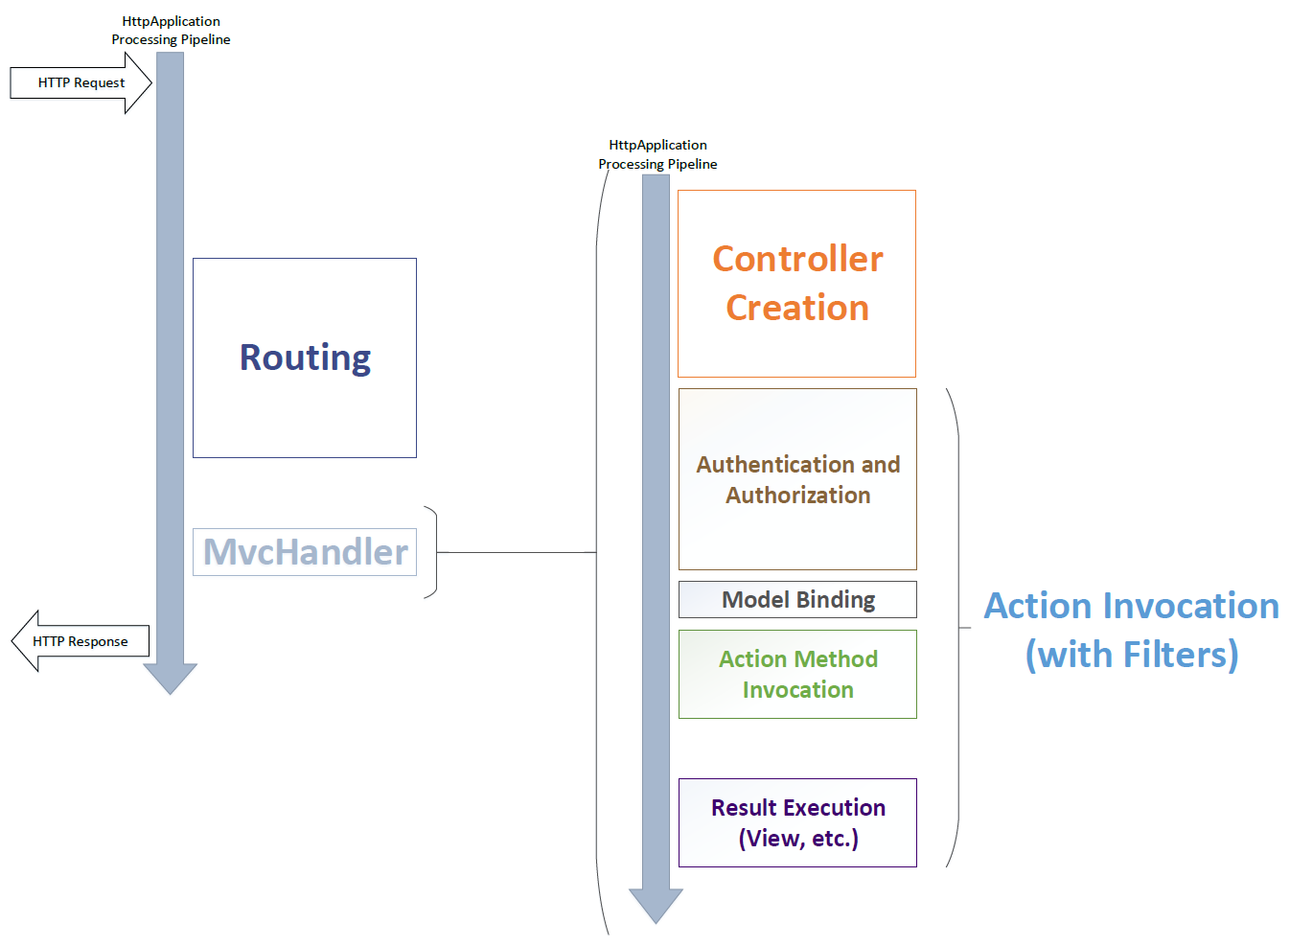
MVC Request Lifecycle

Slide 5
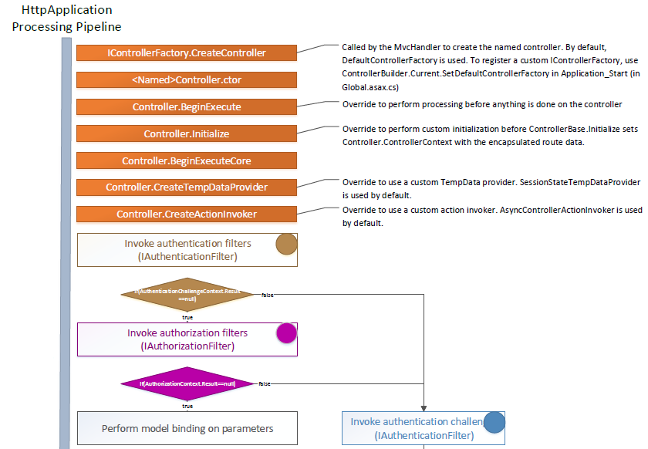
MVC Handler Lifetime – Part 1

Slide 6
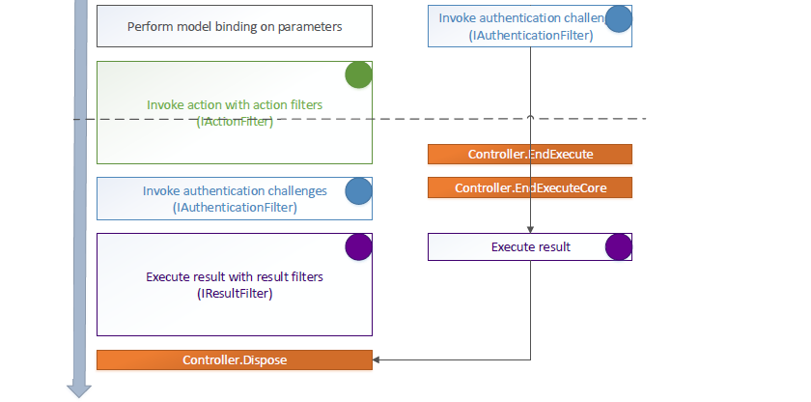
MVC Handler Lifetime – Part 2

Slide 7
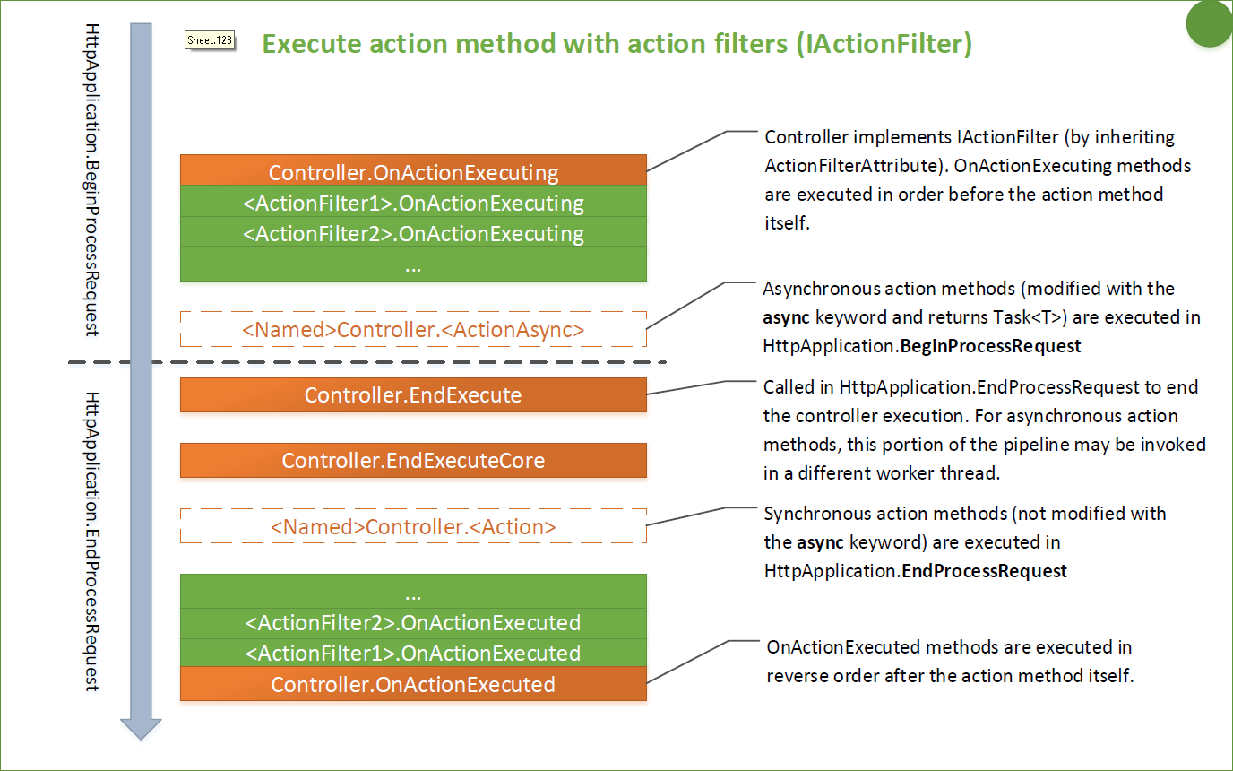
Action Method Execution

Slide 8
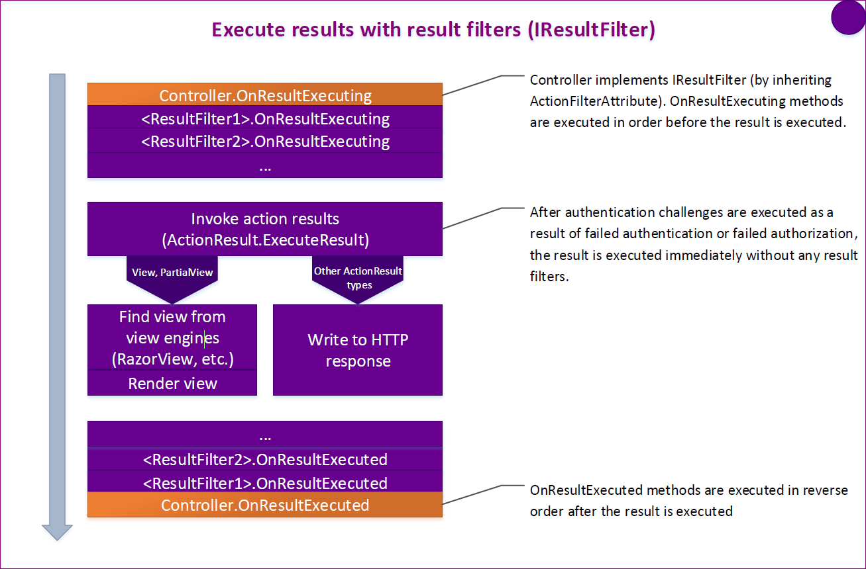
Execute Results

Slide 9

Performance Tips
Optimizing ASP.NET MVC applications

Slide 10
Performance Advices
Disable unused view engines
Global.asax
When accessing data via EF rely on IQueryable
Profile your queries
Use caching
Run in Release mode
Avoid passing null ViewModels to Views
ViewEngines.Engines.Clear();
ViewEngines.Engines.Add(new RazorViewEngine());

Slide 11
Performance Advices (2)
Uninstall URL Rewrite if you don’t use it
Html.ActionLink check if the URL is rewritten
Use performance profiler (load and performance tests) to measure
Use local storage for frequently accessed non sensitive information
Use Bundling – concatenating multiple files into a single download
Use Minification – making the download file as small as possible

Slide 12
Bundles in ASP.NET MVC
Configure bundles
Add bundles to the global bundle table
Specify a global virtual path
Be careful with relative images paths
Include the files in the bundle.
Use wildcards (*) to avoid issues with file versions
Register bundle table during application startup
<compilation debug="true" />
BundleTable.EnableOptimization = true;

Slide 13
Performance Advices (3)
Use Load balancing
Use Asynchronous Controllers to implement actions that depend on external resources
Add gzip (HTTP compression) and static cache (images, css, ...) in your Web.config
Remove unused HTTP Modules
<system.webServer>
<urlCompression doDynamicCompression="true" doStaticCompression="true" dynamicCompressionBeforeCache="true"/>
</system.webServer>

Slide 14
Client Performance Advices (4)
Use CSS sprites
Use a Content Delivery Network (CDN)
Put stylesheets at the top
Make JS and CSS external
Put JavaScripts at the bottom
Pre-load/Post-load Components
Reduce the number of DOM elements
Optimize images and CSS sprites
Don't Scale Images in HTML (resize)
Reduce Cookie Size

Slide 15

Localization and Resources

Slide 16
Localization and Culture
Cultures in .NET specify formatting / parsing settings specific to country / region / language
Thread.CurrentCulture property
Example: DateTime.Now.ToString()
Thread.CurrentUICulture impacts resource load
Accept-language header
<system.web>
<globalization culture="auto" uiCulture="auto" />
. . .
</system.web>

Slide 17
Resources
*.resx files that store localized text
Strings.resx stores default resources
Strings.bg.resx stores resource for Bulgarian
Add the *.resx files to App_GlobalResources or App_LocalResources (depending on their use)
Resource manager loads appropriate file
Build action – embedded resources
Resources could be used in views, models, controllers, data annotations

Slide 18

Localizing ASP.NET MVC Application
Live Demo

Slide 19

Diagnostics and Health Monitoring
Health Monitoring, Elmah and log4net

Slide 20
Diagnostic and Monitoring
When application started and shutdown
Unhandled exceptions – stack traces
Security related diagnostics
Malicious user tries to access unauthorized area
When a user logged in
Tracing is a great feature for monitoring ASP.NET Web Forms projects (Lifecycles events)
Errors can be send on email, log in a file or save in a database

Slide 21
Health Monitoring
The built in system in ASP.NET for creating, monitoring and publishing diagnostic info
The settings for this monitoring system are set in the machine level web.config file C:\Windows\Microsoft.NET\Framework\{.NET version}\Config\web.config
<eventMappings>- Map specific types of errors to an event
<rules>Routed events to a provider
<providers>Set where to store diagnostic info

Slide 22
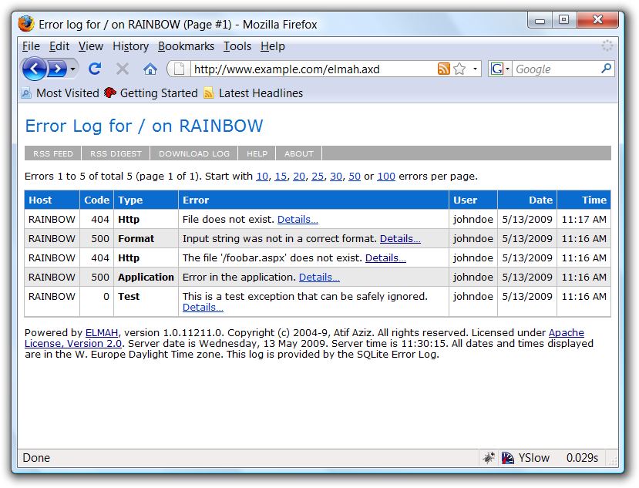
Elmah
Exceptions logging modules and handlers
Install through NuGet – Elmah.MVC
It defines some basic settings in web.config
Register global filter in the FilterConfig class
HandleErrorWithElmahAttribute class

Slide 23
Elmah configuration
Configure Elmah in the web.config
<elmah>
<security allowRemoteAccess="true" />
<errorLog type="Elmah.XmlFileErrorLog, Elmah" logPath="~/App_Data/Elmah" />
</elmah>
<location path="elmah.axd">
<system.web>
<authorization>
<allow roles="Administrator" />
<deny users="*" />
</authorization>
</system.web>
</location>
http://code.google.com/p/elmah

Slide 24

ASP.NET MVC Good Practices

Slide 25
Good Practices
Use ViewModels and Input Model Validation
Add namespaces to Views
Use strongly typed views
Avoid the ViewBag
Use Dependency Container
Explore the ASP.NET MVC source code
http://aspnetwebstack.codeplex.com/
https://github.com/aspnet/mvc

Slide 26
Isolate your layers properly
ViewModel for transmitting data to the view
simple POCO de-normalized objects
Use AutoMapper for automating projections
Use Controllers for selecting the view to be shown and not for business logic
Use the view for displaying Html which will be rendered by the browser
Not for business logic!
Use Services/Repositories for manipulating business objects

Slide 27
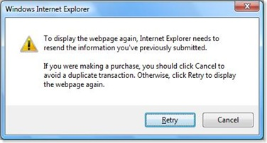
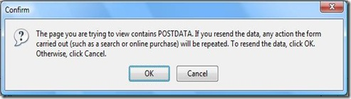
Use the PRG (PostRedirectGet)
Prevent reposts to the form
Issues an HTTP 302 with temporary redirect
Use proper verbs [HttpPost], [HttpGet] on you controllers
Saving Temporary Data Across Redirects – TempData Dictionary

Slide 28

Productivity Tips
Use "NuGet" packages that help with productivity
RouteDebugger – debugging routes
Glimpse with add-ons – for debugging
ELMAH – error logging
MvcScafolding
Visual Studio Add-ons
JustCode (ReSharper)
Web Essentials

Slide 29
Other tips
You can extend using HttpModules, HttpHandlers
HTML5 support
Easier deployment + minification (Including cloud deployment)
Asynchronous / Await
Tooling (Page Inspector, Browser Link, YSlow, Web Developer Toolbar, F12)
Web Sockets / SignalR / AJAX

Slide 30
Think about the market!
Make you application support globalisation if its going to be on the internet
Don’t forget to make accessibility
http://plugins.jquery.com/project/KeyTips
Mobile phone support improvements
Search Engines Optimization (SEO)

Slide 31
ASP.NET MVC Advanced Topics
http://academy.telerik.com

Slide 32



Free Trainings @ Telerik Academy
“C# Programming @ Telerik Academy
csharpfundamentals.telerik.com
Telerik Software Academy
academy.telerik.com
Telerik Academy @ Facebook
facebook.com/TelerikAcademy
Telerik Software Academy Forums
forums.academy.telerik.com

